Slide 1
Azure AD for non-developers
Rory Braybrook
Microsoft Identity Architect
Microsoft MVP (Enterprise mobility)
@rbrayb

Slide 2
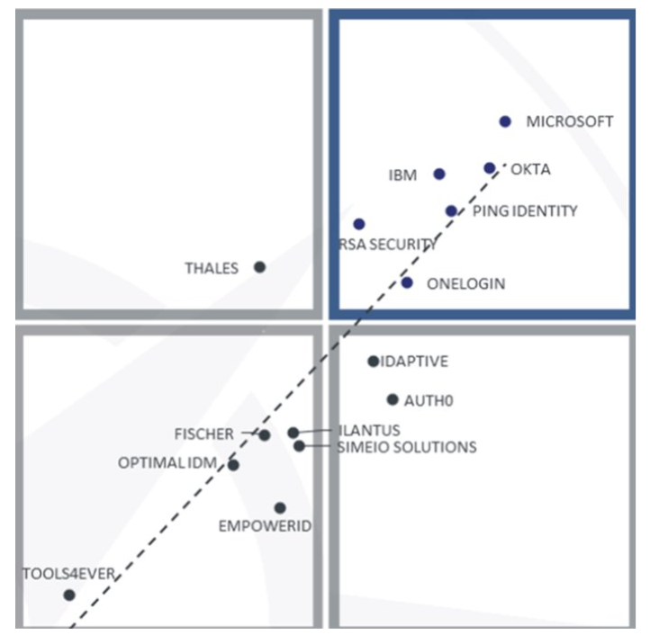

Slide 3

Azure AD
Identity is the new control plane

Slide 4
Identity is the new control plane
IT security
The right application
at the right time
to the right people
with the right permissions
Identity is an organization’s access guard to the new cloud world.
Organizations need an identity control plane that strengthens their security and keeps their cloud apps safe from intruders.

Slide 5
Digital Transformation
Key computing trends
+
+
+
Cloud
Mobile
IoT
Digital
Many applications and services
Many devices and applications
Billions of devices and things
Many corporate & personal personas
Multiple identities
+
Multiple identities
+
Multiple identities
+
Multiple identities

Slide 6


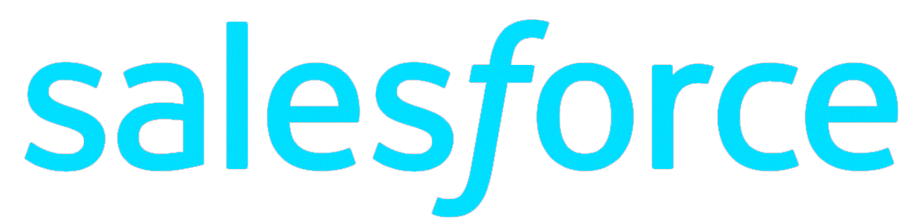


CLOUD APPS AND SAAS SERVICES
On-premises

Slide 7






MOBILE AND PERSONAL DEVICES
On-premises

Slide 8
ORGANIZATION & SOCIAL IDENTITIES
On-premises

Slide 9
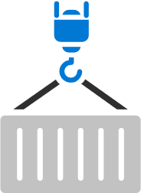
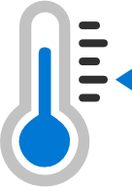
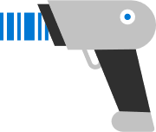
INTERNET OF THINGS (IOT) DEVICES
On-premises
Organization and social identities

Slide 10




On-premises

Slide 11


Identity is the new control plane
Partners & Customers
Cloud Apps
Employees
Identity
On-premises & web apps
Devices

Slide 12
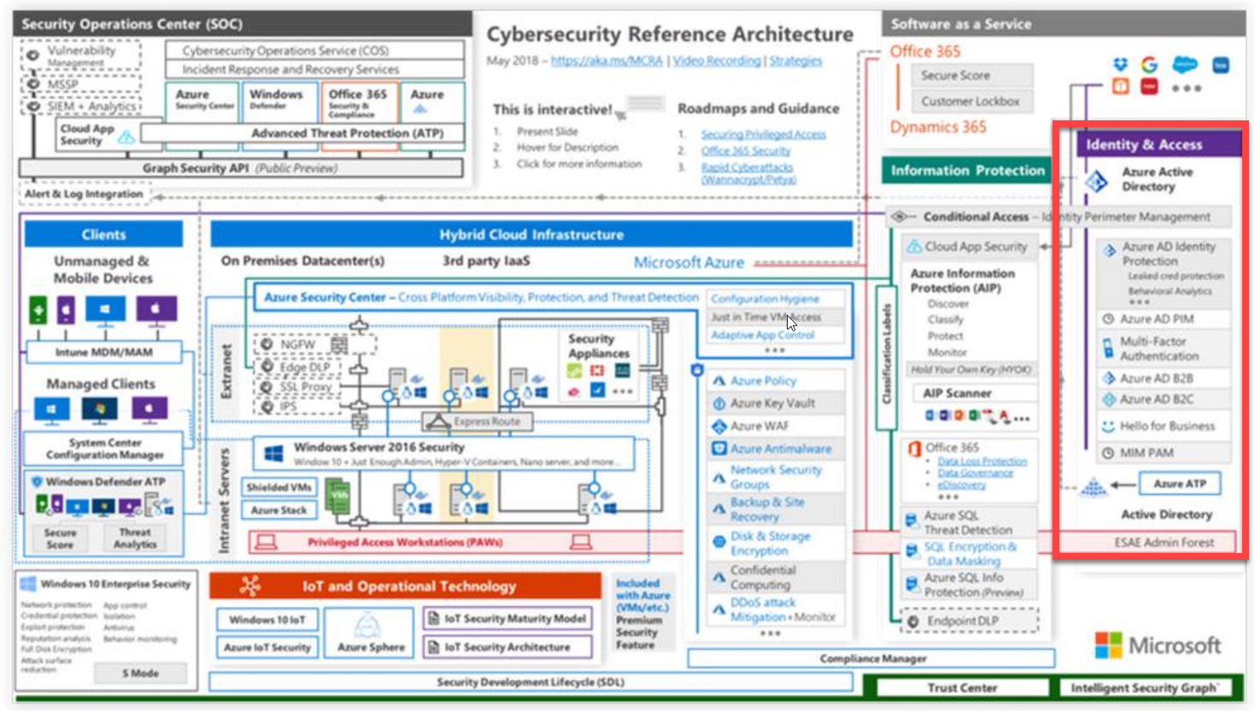

Slide 13
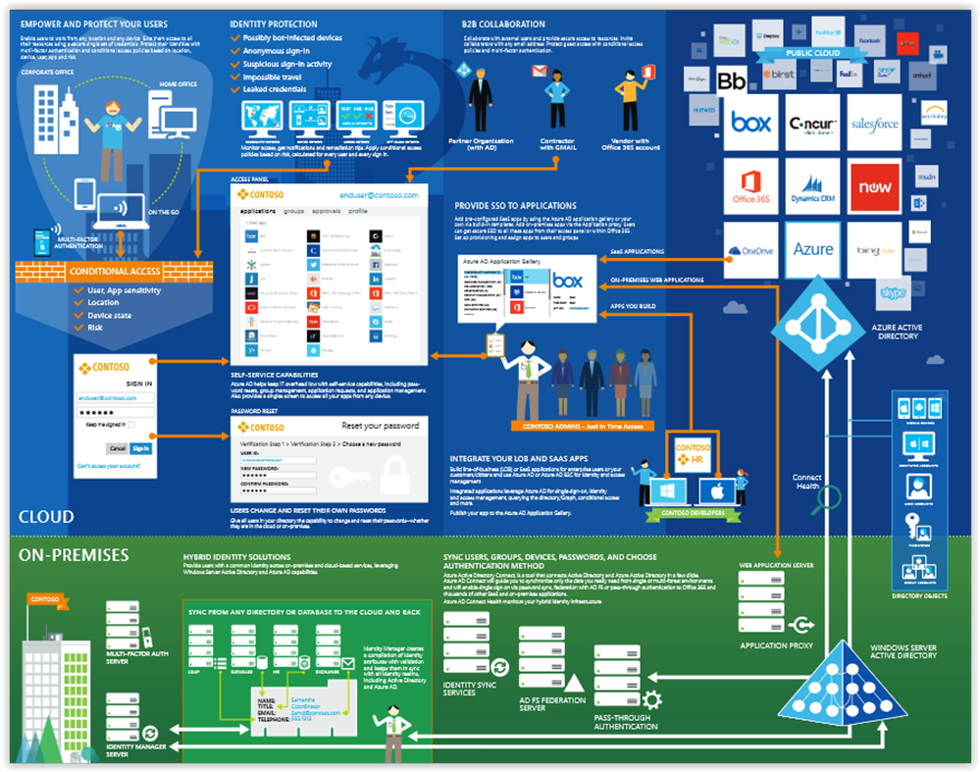

Slide 14
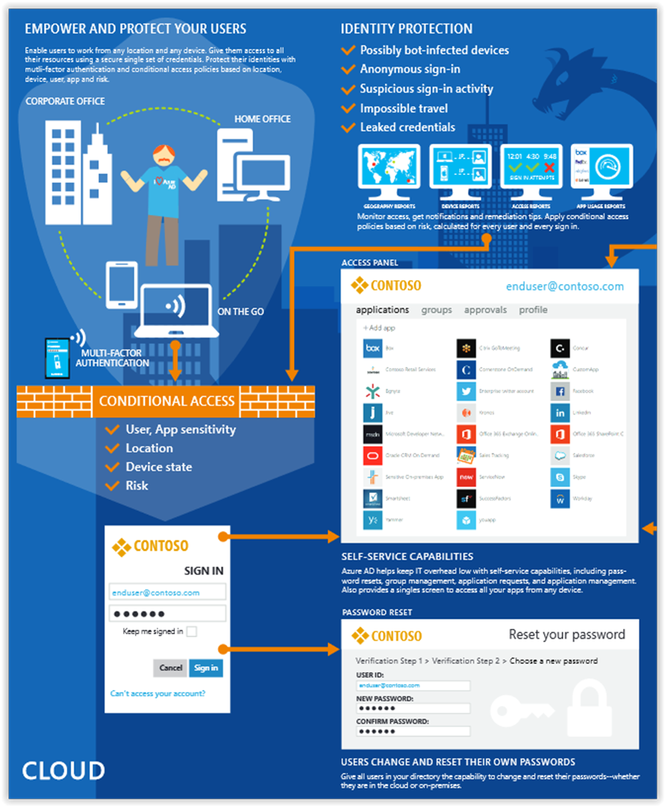

Slide 15
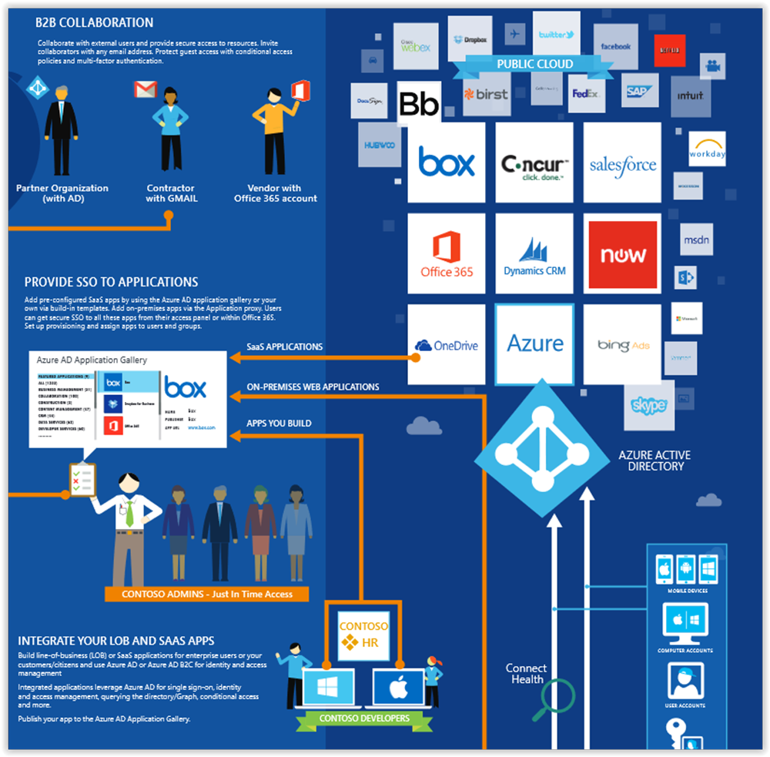

Slide 16
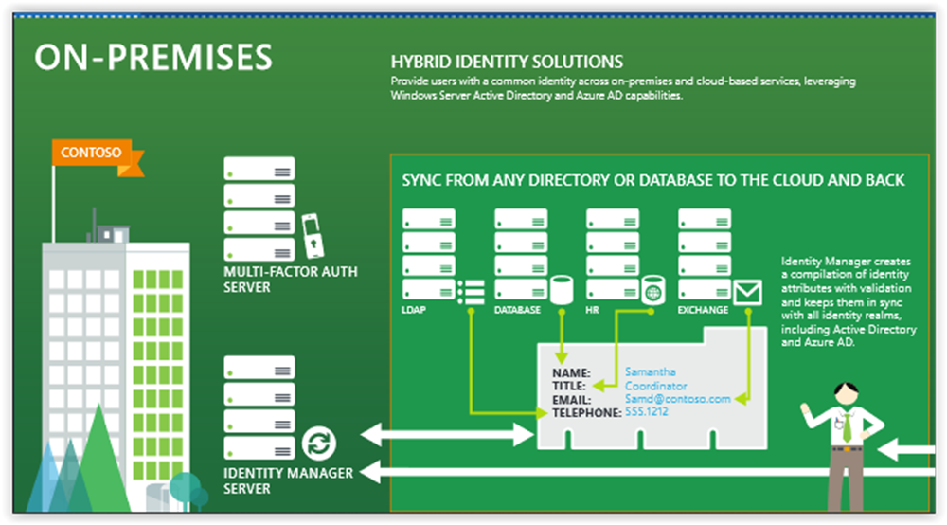

Slide 17
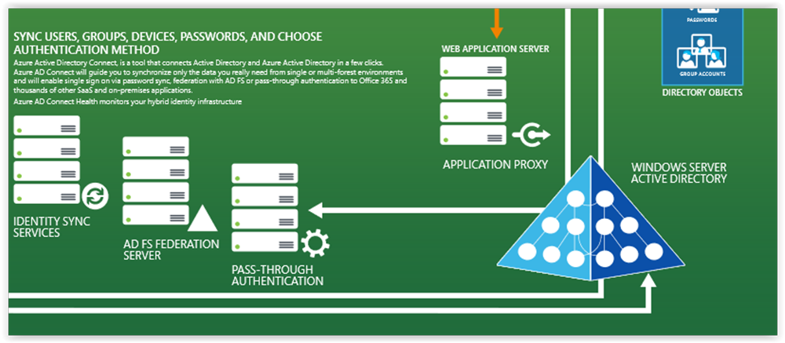

Slide 18
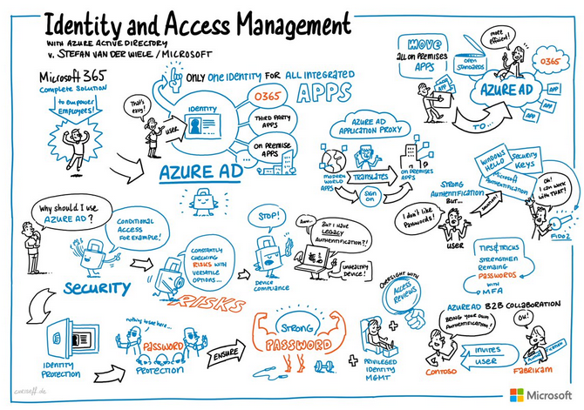

Slide 19
Azure AD
Not AD in the cloud
Graph API not LDAP calls
Not hierarchical
Underpins Office 365
Azure AD manages more than 1.2 billion identities and processes over 8 billion authentications every day

Slide 20




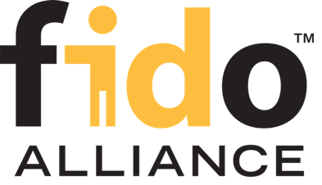

Open Standards
 |  |  | WS-Fed
WebAuthn

Slide 21



Authentication Scenarios
Browser
Web application
Web API
js
Native app
Web API
Web API
Server app
Clients using wide variety of devices/languages/platforms
Server applications using wide variety of platforms/languages

Slide 22
Authentication Scenarios
WS-Fed, SAML 2.0, OpenID Connect
Web application
OAuth 2.0
Web API
Browser
js
OAuth 2.0
Native app
OAuth 2.0
Web API
Web API
Server app
OAuth 2.0
OAuth 2.0
Standard-based, http-based protocols for maximum platform reach

Slide 23
Pricing
Azure Active Directory Free. Provides user and group management, on-premises directory synchronization, basic reports, self-service password change.
Azure Active Directory Premium P1. In addition to the Free features, P1 also lets your hybrid users access both on-premises and cloud resources. It also supports advanced administration, such as dynamic groups, self-service group management, and cloud write-back capabilities, which allow self-service password reset for your on-premises users.
Active Directory Business-to-Customer (B2C).

Slide 24
Pricing
Azure Active Directory Premium P2. In addition to the Free and P1 features, P2 also offers Azure Active Directory Identity Protection to help provide risk-based Conditional Access to your apps and critical company data and Privileged Identity Management to help discover, restrict, and monitor administrators and their access to resources and to provide just-in-time access when needed.
"Pay as you go" feature licenses. You can also get additional feature licenses, such as Azure Active Directory Business-to-Customer (B2C).

Slide 25
Features
Application management – AAD App Proxy, MyApps (Access panel), SaaS
Authentication - self-service password reset, Multi-Factor Authentication, custom banned password list, smart lockout
B2B – guest users, invite, federation, Google
B2C – customer self-service
Conditional access – access rules
Identity platform – set of libraries for dev.
Device Management – Intune – mobile
Entitlement management

Slide 26
Features
Domain services – DC aaS
Enterprise users – SAML (plus provisioning)
Hybrid identity – AAD Connect, Connect Health
Identity protection – ML to detect potential vulnerabilities
Privileged identity management (PIM) – manage admins.
Reports and monitoring

Slide 27
Features
MyApps
AAD Connect
Connect Health

Slide 28
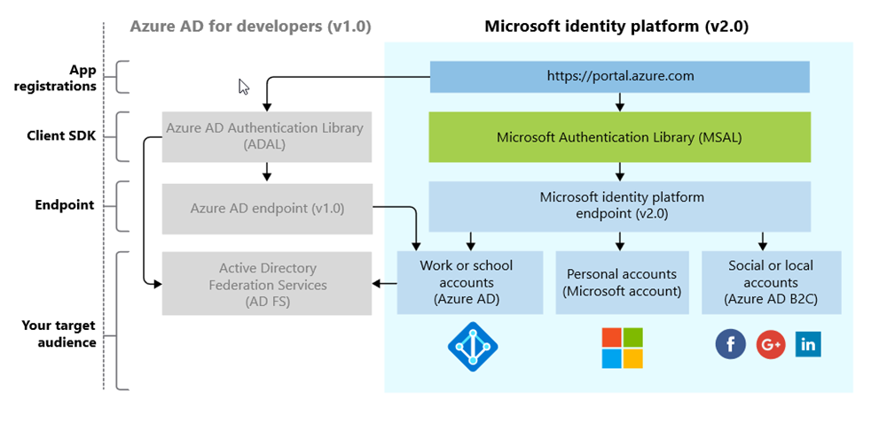
The Microsoft Identity Platform (not the Product!)

Slide 29






Microsoft Authentication Libraries (MSAL)
Generally Available:
GA
GA
GA
GA
GA
GA
JavaScript
.NET
Android
iOS/macOS
Production Supported Public Preview:
PREVIEW
PREVIEW
Java
Python

Slide 30
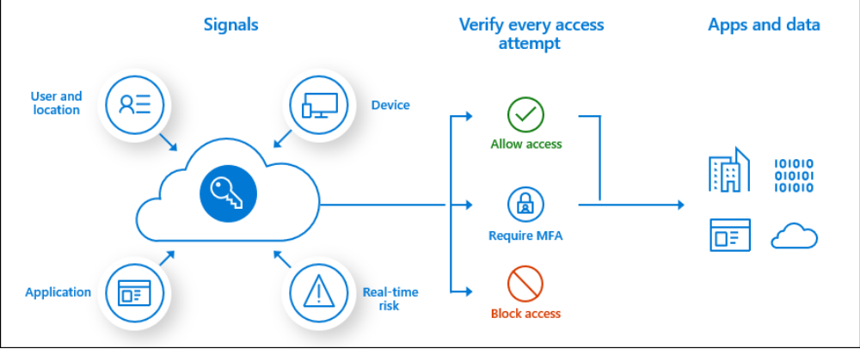
Conditional access

Slide 31
Conditional access
User or group membership
IP Location information
Device
Application
Real-time and calculated risk detection
Microsoft Cloud App Security (MCAS)

Slide 32








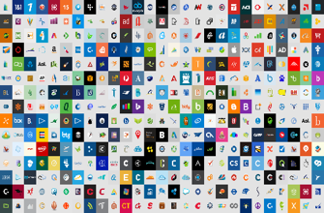


Azure AD
ADFS
Conditions
Controls
MSA
40TB
Google ID
Employee & Partner Users and Roles
Allow/block
access
Microsoft Cloud
Android
Session Risk
iOS
Trusted & Compliant Devices
Machine learning
3
MacOS
Limited
access
Microsoft Cloud App Security
Windows
Windows Defender ATP
Require
MFA
Real time Evaluation
Engine
Cloud SaaS apps
Force
password
reset
Geo-location
Physical & Virtual Location
******
Corporate Network
Policies
Effective policy
Client apps & Auth Method
Block legacy authentication
Browser apps
Client apps
On-premises & web apps

Slide 33
Risk detections
Users with leaked credentials
https://haveibeenpwned.com/
Sign-ins from anonymous IP addresses
Impossible travel to atypical locations
Sign-ins from infected devices
Sign-ins from IP addresses with suspicious activity
Sign-ins from unfamiliar locations

Slide 34

6.5 trillion correlated signals per day
Shared threat data from partners, researchers, and law enforcement worldwide
Microsoft Intelligent Security Graph
OneDrive
930M threats detected on devices every month
Outlook
400B emails analyzed
1.2B devices scanned each month
200+ global cloud consumer and commercial services
Botnet data from Microsoft Digital Crimes Unit
Windows
Enterprise security for 90% of Fortune 500
Azure
Microsoft accounts
18B+ Bing web pages scanned
Bing
450B monthly authentications
1.1B+ Azure user accounts
Xbox Live

Slide 35

Azure Active Directory Identity Protection Service
Azure AD & Microsoft Account
Schroedinger's User
Credentials
Classifier
Microsoft Azure Active Directory
Seems
Good
Seems
Bad
Learner
Analysis
Deploy
10+ TB Logs
Relying parties
Self-reporting
Threat data
Behavior
Update
True Negative
True Positive
Analyze
Inputs & Outcomes
We were right!
False Negative
False Positive
We were wrong!

Slide 36
Hybrid
Authentication
Azure AD App proxy

Slide 37
Hybrid identity infrastructure
Single sign-on
MFA
Self Service
Azure AD Connect
Windows Server Active Directory
Microsoft Azure
Active Directory
On-premises / Private cloud

Slide 38
Cloud authentication with PHS and PTA
Least deployment effort
No real-time on-prem dependency
Leaked credential protection
Cloud-only
Password Hash Sync (PHS) + Seamless SSO
Need help to choose? aka.ms/auth-options
Pass-through Authentication (PTA) + Seamless SSO
Re-use Active Directory policies
Light weight agents deployed
No inbound networking
Smartcard & certificate authentication
On-premises MFA server
Multi-site on-premises authentication
Federation
(AD FS / 3rd party providers)

Slide 39


On-prem app SSO with Azure AD Application Proxy
https://appX-contoso.msappproxy.net/
Azure Active Directory
Azure or 3rd Party IaaS
Connect any claims-aware on-premises web app to Azure AD.
Enable single sign-on to both SaaS apps and on-premises apps via the MyApps portal.
Application
Proxy
connector
DMZ
connector
connector
connector
app
app
app
app
VPN
On-premises apps

Slide 40
MyApps (Access panel)

Slide 41
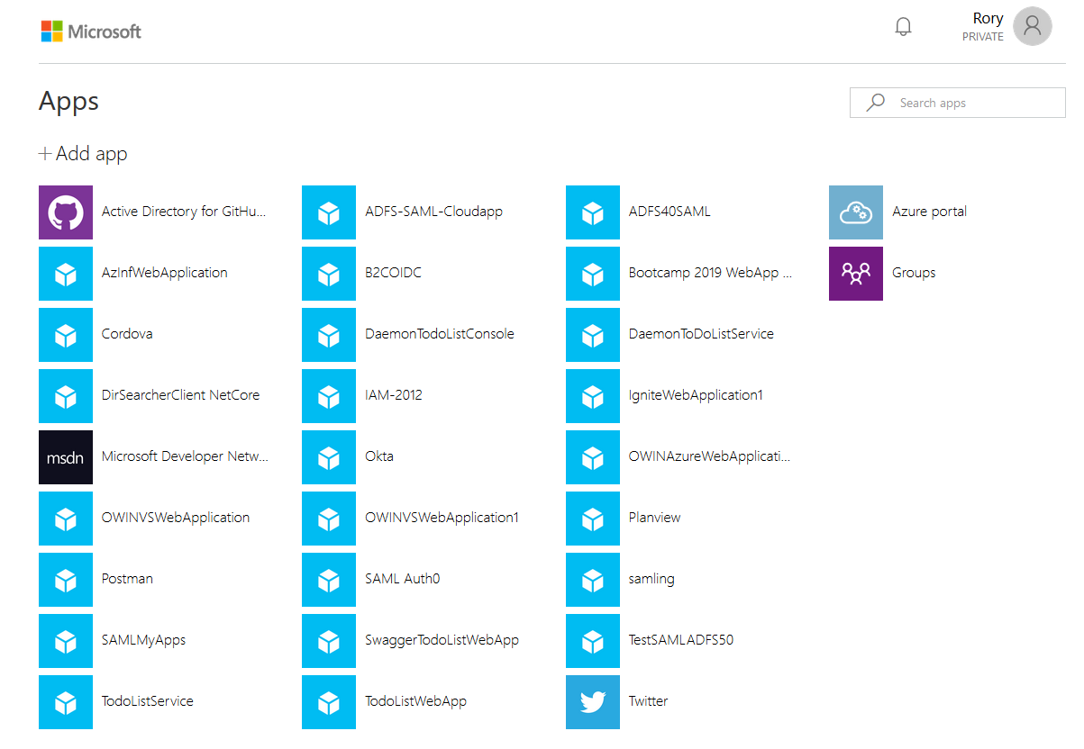
myapps.microsoft.com

Slide 42
Best practice
Treat identity as the primary security perimeter
Turn on Conditional Access
Enforce multi-factor verification for users
Prevents 99.4 % of hacking attempts
Use role-based access control
Enable single sign-on

Slide 43
Demo

Slide 44
What is?
SIEM - Security Information and Event Management
SOAR - Security Orchestration, Automation and Response
MSSP - Managed Security Service Provider
FIDO - Fast ID Online
FIDO2 - WebAuthn(the client API) and CTAP(the authenticator API)
CTAP - Client to Authenticator Protocols
DIF - Decentralized identity Foundation
SCIM - System for Cross-domain Identity Management
ATP – Advanced Threat Protection

Slide 45
References
https://azure.microsoft.com/mediahandler/files/resourcefiles/cloud-identity-and-access-management/Cloud_Identity_and_Access_Management_infographic.pdf/
https://aka.ms/mcra
https://docs.microsoft.com/en-us/azure/active-directory/develop/
https://medium.com/the-new-control-plane

Slide 46


